Slide 1
MAT 3749 Introduction to Analysis
Section 2.1 Part 1
Precise Definition of Limits
http://myhome.spu.edu/lauw

Slide 2
References
Section 2.1

Slide 3
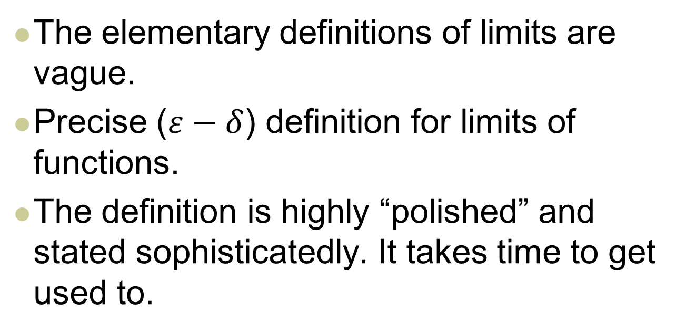
Preview
The elementary definitions of limits are vague.
Precise ($ε−δ$) definition for limits of functions.
The definition is highly “polished” and stated sophisticatedly. It takes time to get used to.

Slide 4
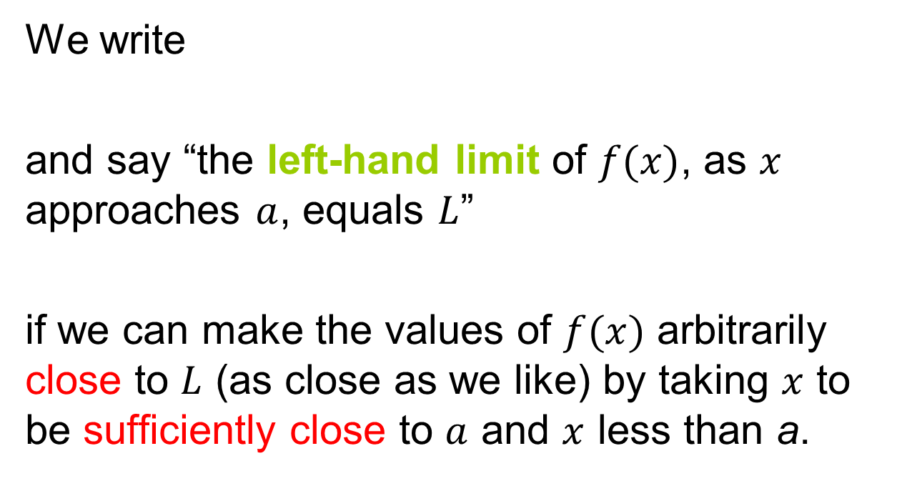
Recall: Left-Hand Limit
We write
and say “the left-hand limit of $f(x)$, as $x$ approaches $a$, equals $L$”
if we can make the values of $f(x)$ arbitrarily close to $L$ (as close as we like) by taking $x$ to be sufficiently close to $a$ and $x$ less than a.

Slide 5
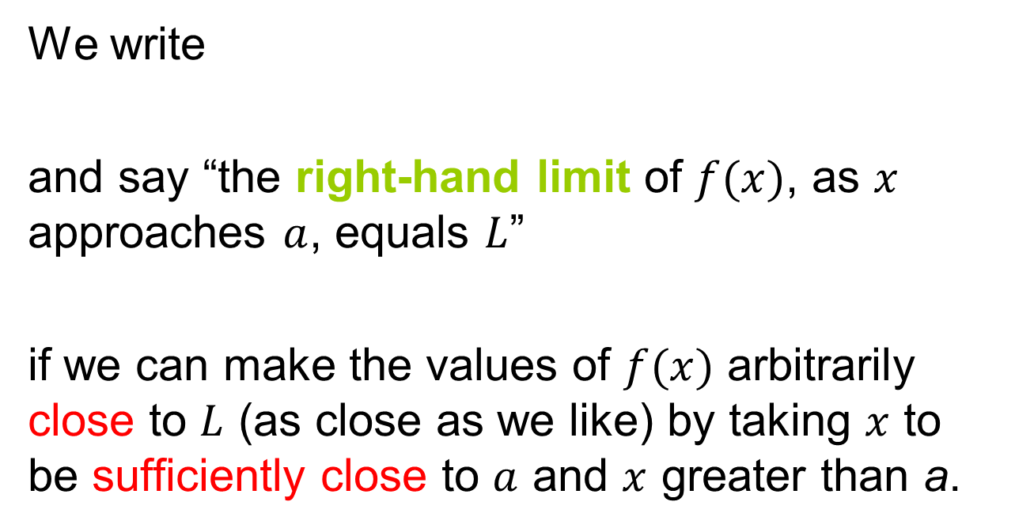
Recall: Right-Hand Limit
We write
and say “the right-hand limit of $f(x)$, as $x$ approaches $a$, equals $L$”
if we can make the values of $f(x)$ arbitrarily close to $L$ (as close as we like) by taking $x$ to be sufficiently close to $a$ and $x$ greater than a.

Slide 6

Recall: Limit of a Function
if and only if
and
Independent of $f(a)$

Slide 7
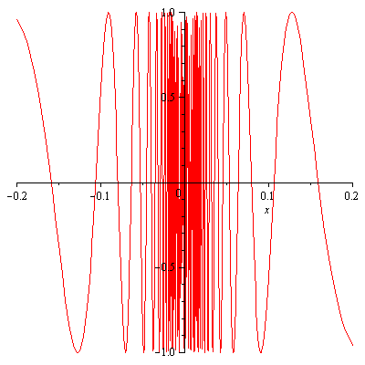
Recall

Slide 8
Deleted Neighborhood
For all practical purposes, we are going to use the following definition:

Slide 9
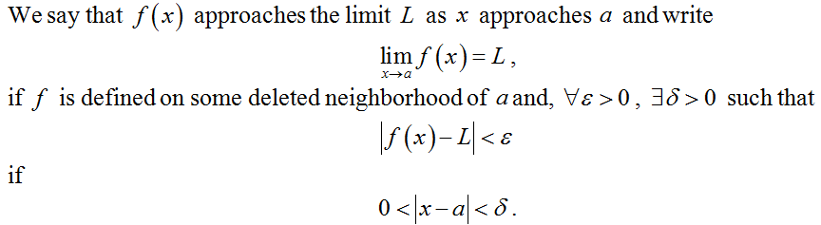
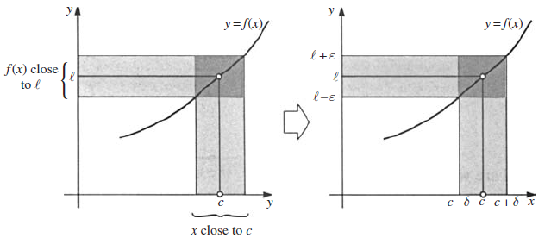
Precise Definition

Slide 10
Precise Definition

Slide 11
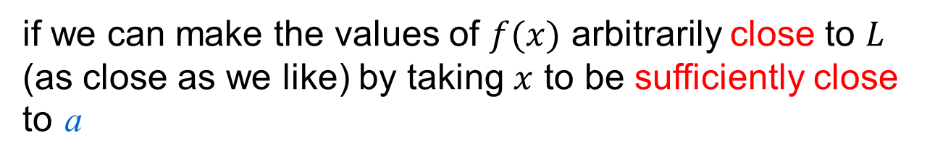
Precise Definition
if we can make the values of $f(x)$ arbitrarily close to $L$ (as close as we like) by taking $x$ to be sufficiently close to a

Slide 12
Precise Definition
if we can make the values of $f(x)$ arbitrarily close to $L$ (as close as we like) by taking $x$ to be sufficiently close to a

Slide 13
Precise Definition
if we can make the values of $f(x)$ arbitrarily close to $L$ (as close as we like) by taking $x$ to be sufficiently close to a

Slide 14
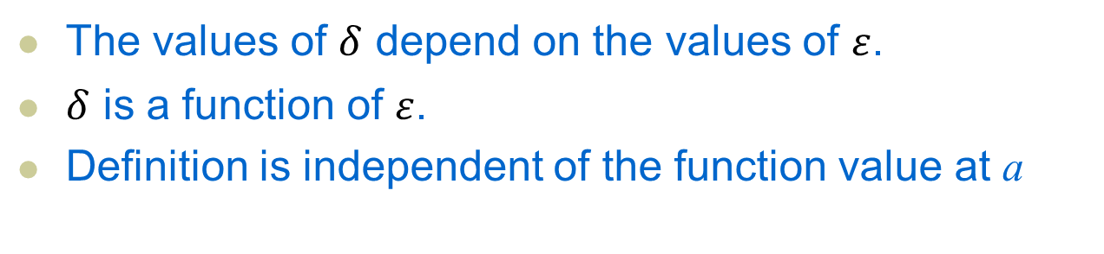
Precise Definition
The values of $δ$ depend on the values of $ε$.
$δ$ is a function of $ε$.
Definition is independent of the function value at a

Slide 15

Example 1
Use the $ε−δ$ definition to prove that

Slide 16
Analysis
Use the 𝜀−𝛿 definition to prove that

Slide 17

Proof
Use the $ε−δ$definition to prove that

Slide 18
Guessing and Proofing
Note that in the solution of Example 1 there were two stages — guessing and proving.
We made a preliminary analysis that enabled us to guess a value for 𝛿. But then in the second stage we had to go back and prove in a careful, logical fashion that we had made a correct guess.
This procedure is typical of much of mathematics. Sometimes it is necessary to first make an intelligent guess about the answer to a problem and then prove that the guess is correct.

Slide 19
Remarks
We are in a process of “reinventing” calculus. Many results that you have learned in calculus courses are not yet available!
It is like …

Slide 20
Remarks
Most limits are not as straight forward as Example 1.

Slide 21
Example 2
Use the 𝜀−𝛿 definition to prove that

Slide 22
Analysis
Use the 𝜀−𝛿 definition to prove that

Slide 23
Analysis
Use the 𝜀−𝛿 definition to prove that

Slide 24
Proof
Use the 𝜀−𝛿 definition to prove that

Slide 25
Questions…
What is so magical about 1 in ?
Can this limit be proved without using the “minimum” technique?

Slide 26
Example 3
Prove that

Slide 27
Analysis
Prove that

Slide 28
Proof (Classwork)
Prove that

